Slide 1


Eighth Annual French Exchange Program
2022-2023
Cambridge High School, Milton, GA
Lycée Vilgénis, Massy, France

Slide 2
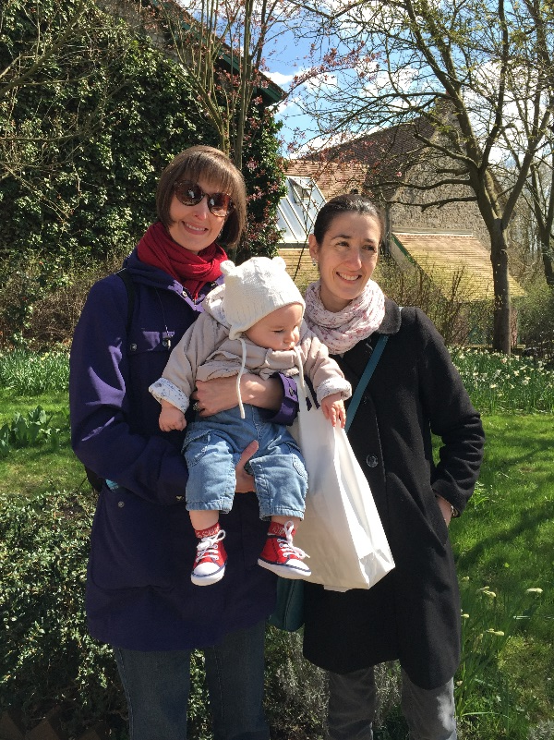
How it came about . . .
Dream: a yearly, mutual exchange with a French high school . . .
2012-13-Mme Dines contacts teacher friend in France, locates school,
negotiates details,
does government paperwork,
plans first exchange
2013-14-Inaugural exchange
2022-23—back for 8th year!
(after 2-year COVID break)

Slide 3
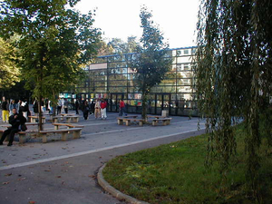
Lycée Vilgénis
Public high school
22 kilometers south of Paris, near Orly airport
On the RER line (Paris region commuter train); 30 minutes from Paris; 20 minutes from Versailles
Official “sister school” attracting more and more students wanting to do the “Atlanta program”

Slide 4

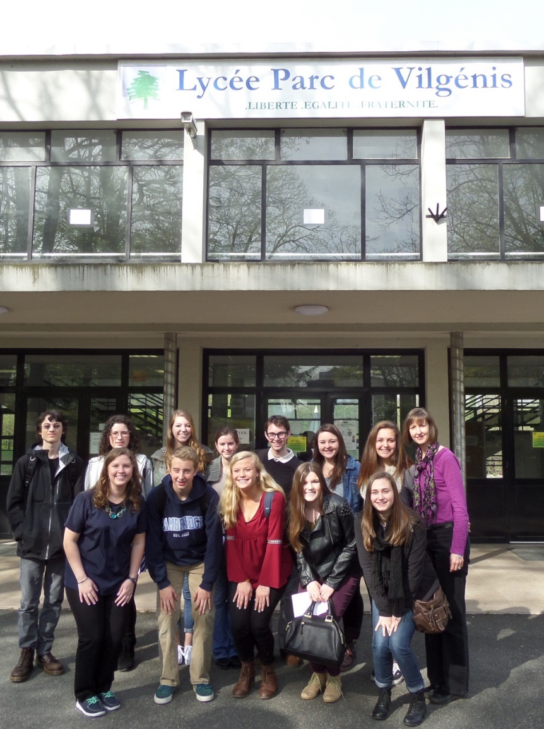
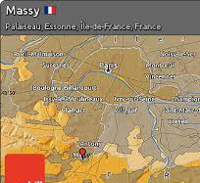
Lycée Vilgénis
www.vilgenis.fr

Slide 5
GOING: Cambridge Students go to France
October 5-15, 2022
Includes 5 missed school days (excused) + teacher work day, PD day, Columbus day
French 3 & above; willing to try to speak French and learn about other cultures
Students will need a passport expiring after 4/20/23. Make plans early for appointment (allow 3 months). Non-US citizens may need a visa or other paperwork. (contact the French consulate in Atlanta). Minors under 16 need both parents present.
Students must be fully vaccinated for COVID (French requirement) and have their vaccine card

Slide 6
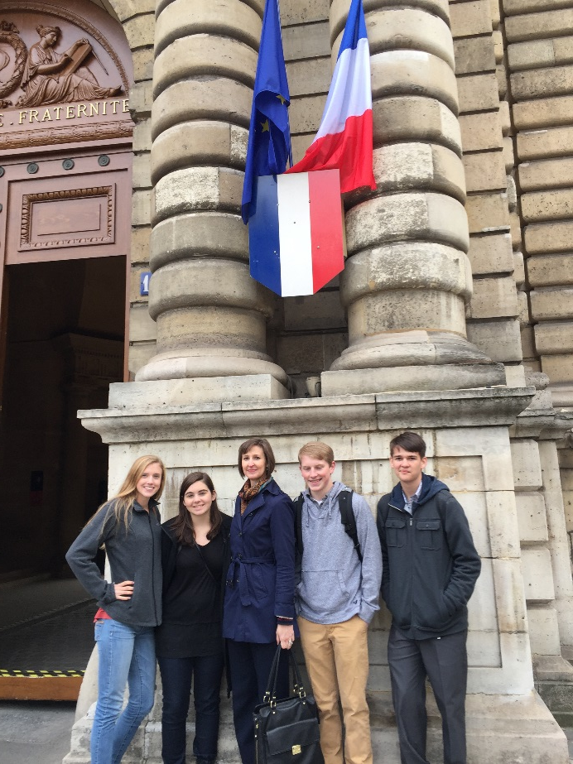
GOING: Cambridge
Students go to France
Cambridge French teachers accompany students
Cambridge students stay
with French host families
Cambridge students attend
school with host students
or do Paris-area trips.
Nights & weekend—with French families

Slide 7
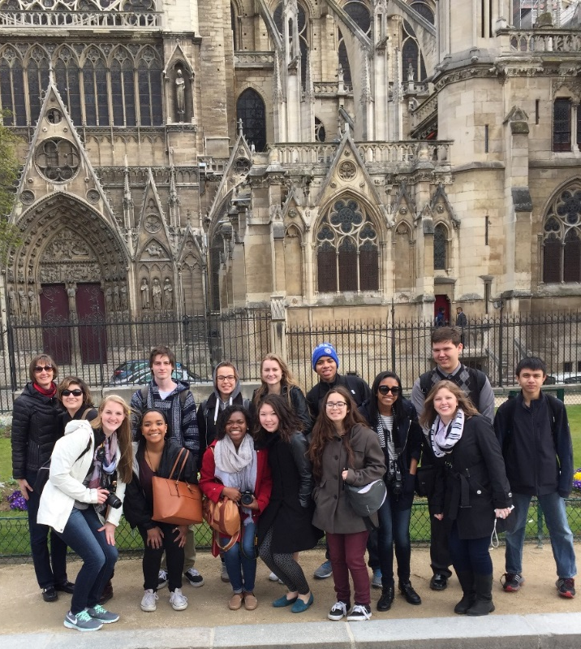
You’re investing in. . .
Your child’s world language education. (French exchange immersion hours > an entire school year of French immersion)
Relationships in France that could last a lifetime
Bonding with CHS classmates
Great for transcripts, résumés,
and college apps
Gaining increased independence
and global perspective in a
controlled environment

Slide 8
French immersion homestay vs. tour
Immersion homestay | Tour
Stay with a French family & participate in their lives (public transportation) | Stay in a hotel; minimal interaction with French people (tour bus isolation)
Learn to use French in an authentic way | Speak minimal French (possibly only English)
Become a savvy international traveler | Fewer chances to function in the culture
See a few historical sites thoroughly | Spend a few minutes at many sites
Class for cultural preparation and debrief | Limited support before & after
Get to know the family and visit many times | Few lasting connections

Slide 9
Details, details
Cost: €1999 (≅ $2250)
Cost with Terre des langues includes:
  plane ticket
  French public transportation pass (RER, metro, bus)
  medical insurance (excludes pre-existing conditions)
  private transportation to and from airport
  Seine river boat cruise, entry & tours of attractions (Louvre, Towers of Notre Dame, Versailles, etc.)
  personnel to assist us in France
Payments: Spread out over 2 payments (in euros, so small fee is charged)

Slide 10
About Terre des langues
French company knows France
85% of staff are teachers/ former teachers
Prices in euros (more affordable)
Pay online via credit card
Support if needed
Organize many types of trips/ exchanges
http://www.terredeslangues.com/pages/index.php

Slide 11
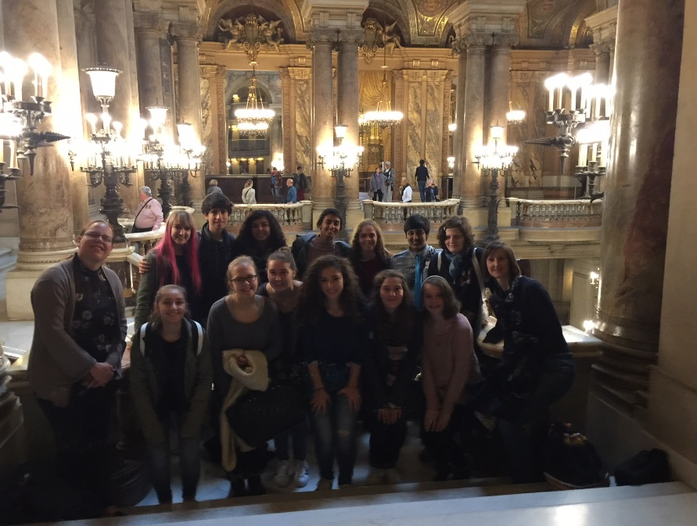
How do I sign up to go??
Now: Fill in the Google Form Application; start getting passport
Pick up the short answer portion of application and take it home to complete
French teachers will look at these and give you the go-ahead
Sign up with
Terre des langues
Seniors get priority

Slide 12

HOSTING: French students at Cambridge
February 2023.
30 students—need host families!
Weekdays at CHS or on field trips; nights & weekend with host families
English teacher Tiphaine Cabot, and 2 other teachers will accompany the students.

Slide 13


How to host . . .
It’s easy!! (and so rewarding.)
Live your normal family life, and the French student participates.
They come to school with your child(ren) everyday.
Pick them up at Hartsfield International airport.
Gain lifetime friends and learn something new
Sign up with your French teacher

Slide 14
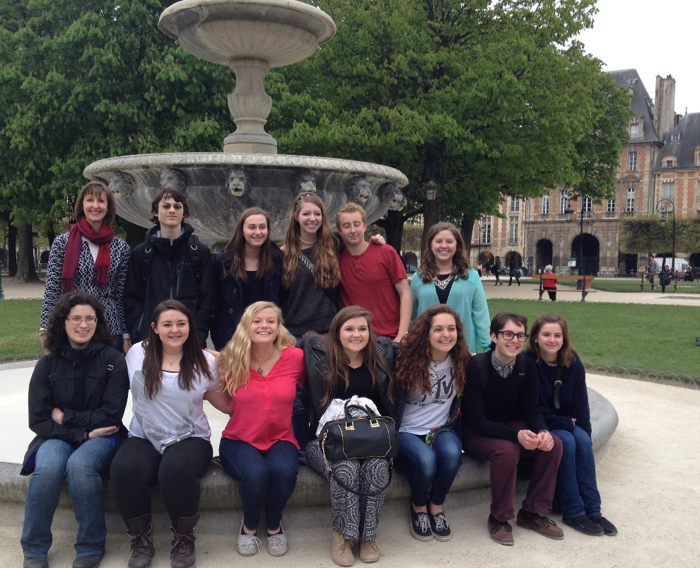
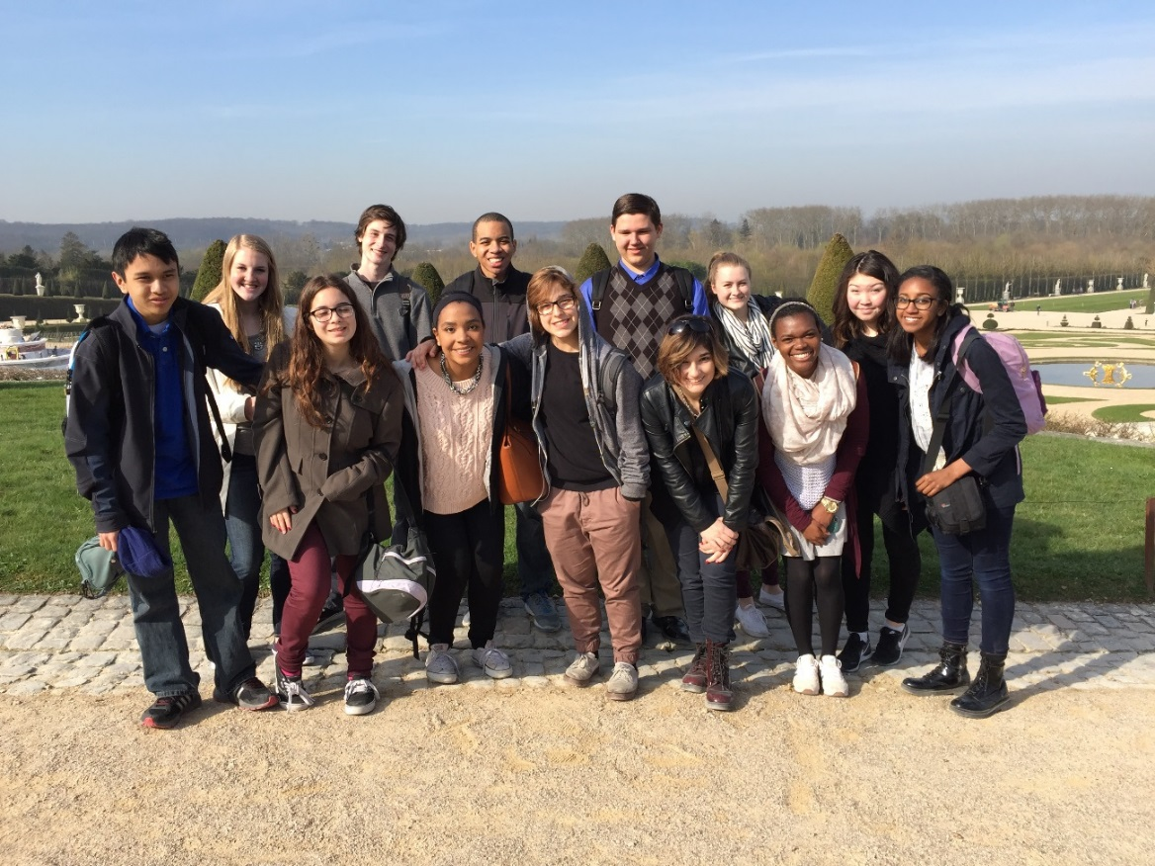
Questions?

