Slide 1
Welcome to 21^{st-}Century World Languages!
A Key to Career Success

Slide 2
21^{st –}Century World Languages

Slide 3
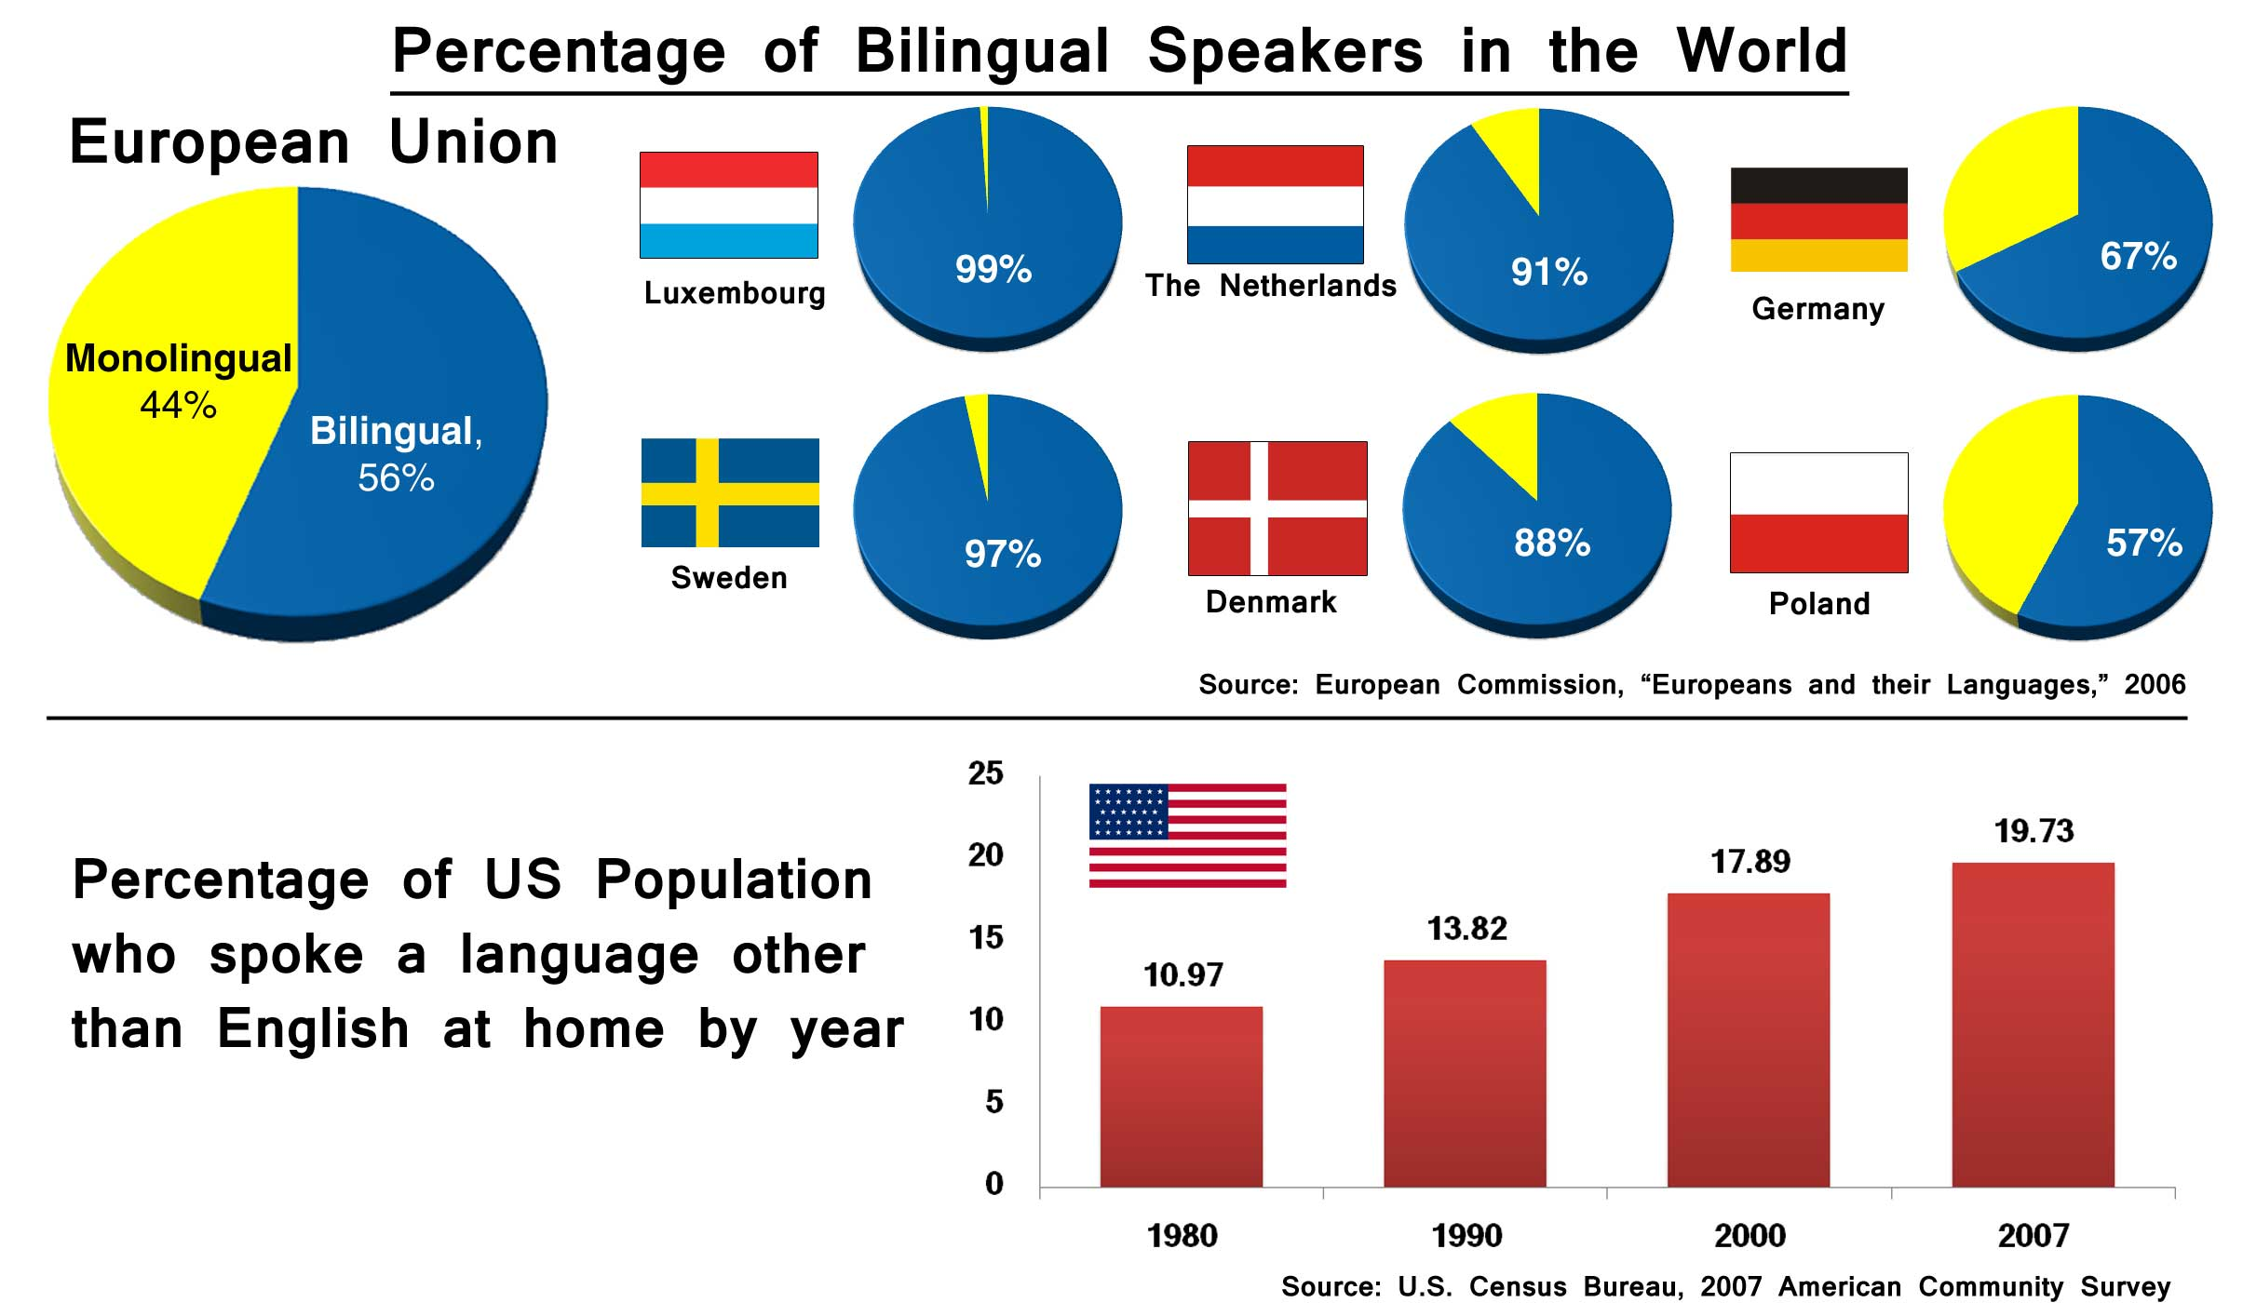
21^{st –}Century World Languages

Slide 4
21^{st –}Century World Languages
For the communication skills needed for career success, students should be proficient in a language, not just know about it.
Able to understand, speak, read, and write in a variety of spontaneous situations
Higher order thinking & problem solving
FCS & CHS moving towards proficiency curriculum

Slide 5
21^{st –}Century World Languages
How do humans learn a language? Through:
Meaningful interaction with other people
Personal connections relevant to the student
A variety of learning experiences
Constant exposure to the language (hearing, reading, interacting with others)

Slide 6
21^{st –}Century World Languages
Personalized Learning in World Languages:
Teacher knows & interacts with student in ways the student responds to
Teacher makes personal connections with students
Teacher addresses gaps in learning by using target language in specific ways

